Slide 1
INVESTMENT CASE STUDY SUBMISSION
Group Name:
Suel Ahmed
Ujval Patel
Vasanth KC
Ranjith Muraleedharan

Slide 2
<Abstract>
CEO of Sparks Funds, an asset management company (an early stage start-up investor) wants to make investments of the size 5-15 million USD per round of investments in few companies based on the global trends in investments. The broad strategy for investments is to:
Invest in English speaking countries and in sectors where most of the investment companies are funding with a capital amount of about 5-15 million USD per round. Since the company is a start-up investor the type of funding that are generally looked at are Angel, Venture, Seed, Private Equity etc.
The investment data to be analysed are taken from crunchbase.com. The goals of analysis are
Investment type analysis – Find the typical investment amount in venture, seed, angel, private equity etc. so that an investment type can be selected based on their investment strategy of investing 5-15 million USD per round
Country Analysis – Find the top English speaking countries where most investments of the preferred investment type is made
Sector Analysis – Understand the main sectors where the investments under the preferred investment type are mostly distributed among the top three English speaking countries.

Slide 3
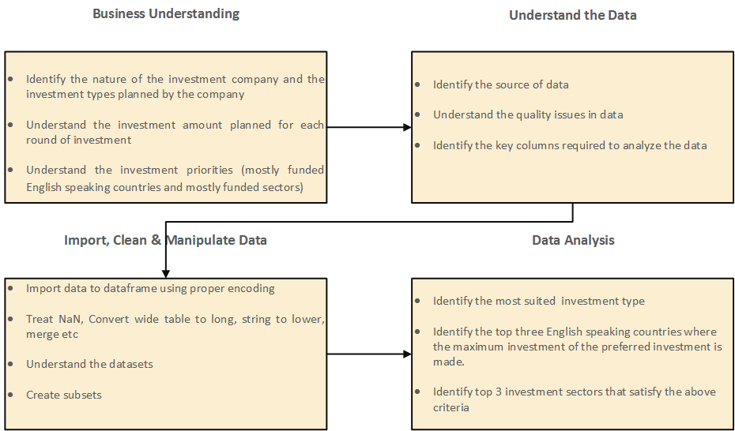
<Problem solving methodology>

Slide 4
<Analysis>
Companies and rounds2 dataframes are joined based on permalink columns after the required clean up and is further joined with mapping table that is converted from wide to long format (with removal of nulls). This dataframe is further analysed to derive the following observations.
Average Values of Investments for Each of these Funding Types
Sl.No | Questions | Answer
1 | Average funding amount of venture type | 11,748,950.00 USD
2 | Average funding amount of angel type | 958, 694.50 USD
3 | Average funding amount of seed type | 719, 818 .00 USD
4 | Average funding amount of private equity type | 73,308,590.00 USD
5 | Considering that Spark Funds wants to invest between 5 to 15 million USD per investment round, which investment type is the most suitable for them? | Venture

Slide 5
<Analysis>
The dataframe is further grouped based on country code and raised amount to arrive at the top 3 English speaking countries with investment type as Venture.
Analyzing the Top 3 English-Speaking Countries
Sl.No | Questions | Answers
1 | Top English speaking country | USA
2 | Second English speaking country | GBR
3 | Third English speaking country | IND

Slide 6
<Analysis>
The dataframe is subsetted for each of the three top countries where raised amount is between 5 and 15 million USD and investment type is Venture. The data is further analysed based on investment sectors to arrive at the following results.
Sector-wise Investment Analysis
Sl.no | Questions | C1 | C2 | C3
1 | Total number of Investments (count) | 12150 | 628 | 330
2 | Total amount of investment (USD) | 108,531,347,515 USD | 5,436,843,539 USD | 2 976 543,602
3 | Top Sector name (no. of investment-wise) | Others, | Others | Others
4 | Second Sector name (no. of investment-wise) | Social, Finance, Analytics, Advertising | Social, Finance, Analytics, Advertising | Social, Finance, Analytics, Advertising
5 | Third Sector name (no. of investment-wise) | Cleantech / Semiconductors | Cleantech / Semiconductors | News, Search and Messaging
6 | Number of investments in top sector (3) | 2950 | 147 | 110
7 | Number of investments in second sector (4) | 2714 | 133 | 60
8 | Number of investments in third sector (5) | 2300 | 128 | 52
9 | For point 3 (top sector count-wise), which company received the highest investment? | Virtustream | Electric Cloud | FirstCry.com
10 | For point 4 (second best sector count-wise), which company received the highest investment? | SST Inc. (Formerly ShotSpotter) | Celltick Technologies | Manthan Systems

Slide 7
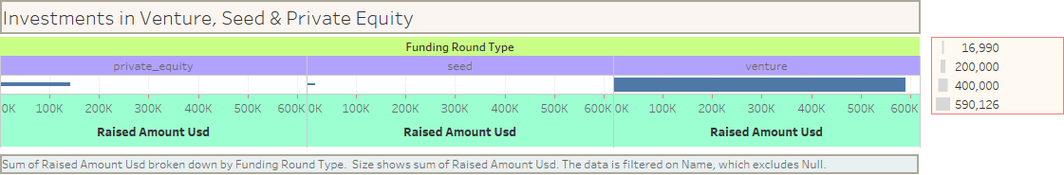
<Results>
Plot 1

Slide 8
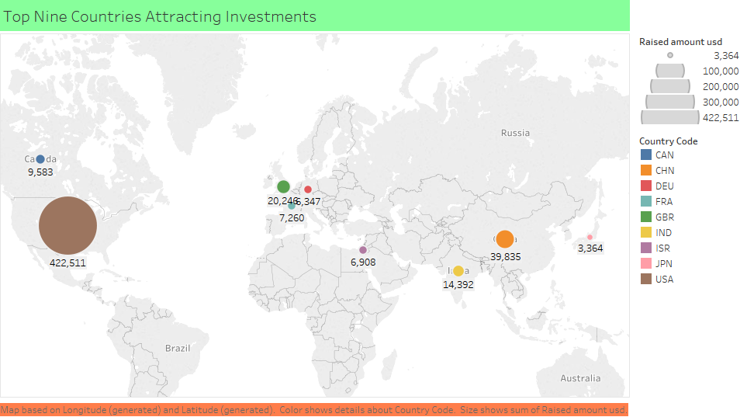
<Results>
Plot 2

Slide 9
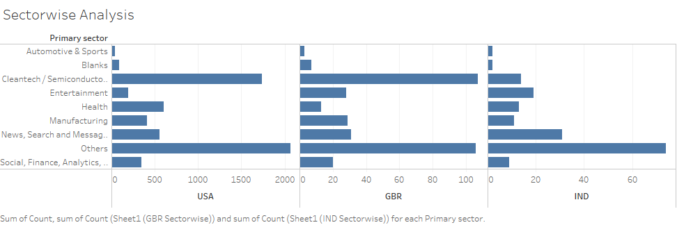
<Results>
Plot 3

Slide 10
<Conclusions>
Based on the analysis, the following conclusions are arrived
Best investment type for Spark Funds to make an investment of 5-15 million USD per round is Venture
Top 3 English speaking countries where investment can be made are USA, Great Britain and India
Top 3 sectors suitable for venture capital investment in USA are Others, Social, Finance, Analytics, Advertising and Cleantech / Semiconductors
Top 3 sectors suitable for venture capital investment in Great Britain are Others, Social, Finance, Analytics, Advertising and Cleantech / Semiconductors
Top 3 sectors suitable for venture capital investment in India are Others, Social, Finance, Analytics, Advertising and News, Search and Messaging

